Slide 1
Threats & controls
Dr. Bhawana Rudra
NITK

Slide 2
Threat: potential for violation of security, which exists when there is a circumstance, capability, action, or event that could breach security and cause harm. That is, a threat is a possible danger that might exploit a vulnerability.
Attack: An assault on system security that derives from an intelligent threat; that is, an intelligent act that is a deliberate attempt (especially in the sense of a method or technique) to evade security services and violate the security policy of a system.

Slide 3
Attacks:
Passive
Release of message contents
Traffic Analysis
Active
Masquerade
Replay
Modification of messages
denial of service

Slide 4
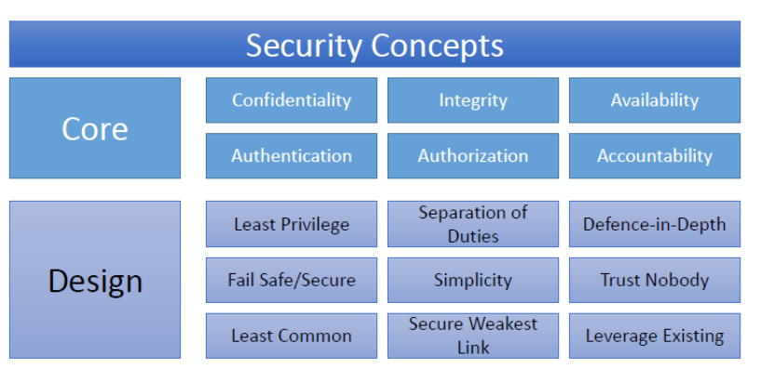
Network Security Principles

Slide 5
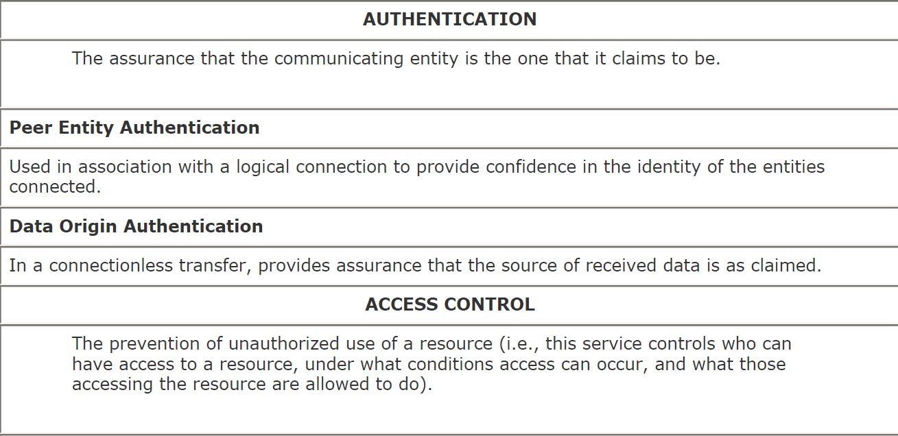
Security Services

Slide 6
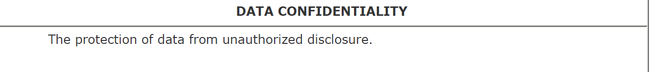
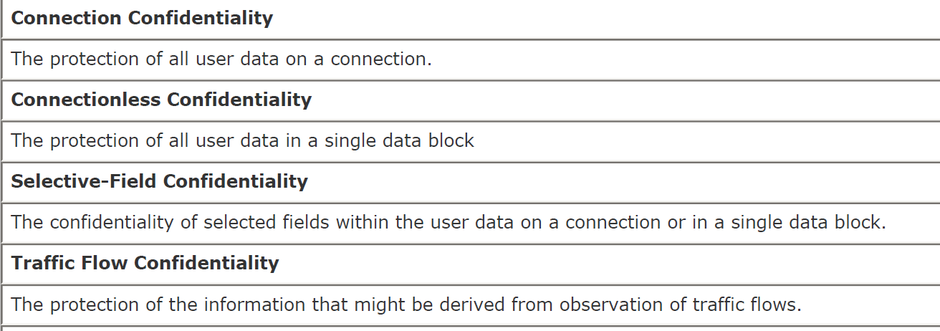

Slide 7
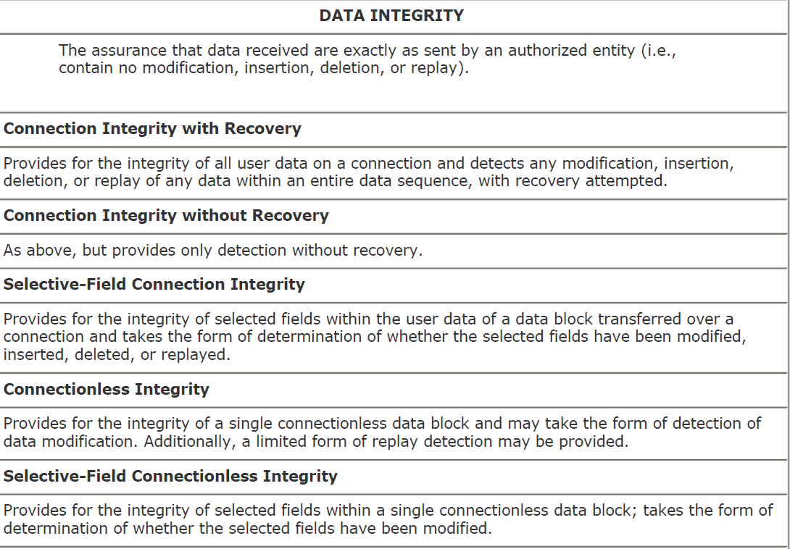

Slide 8
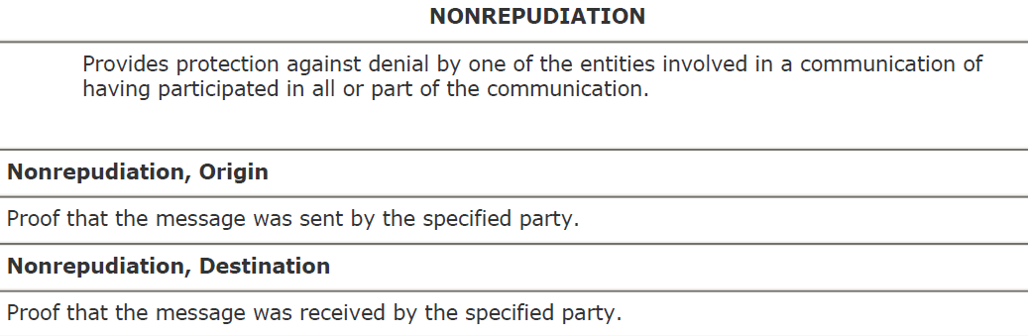

Slide 9
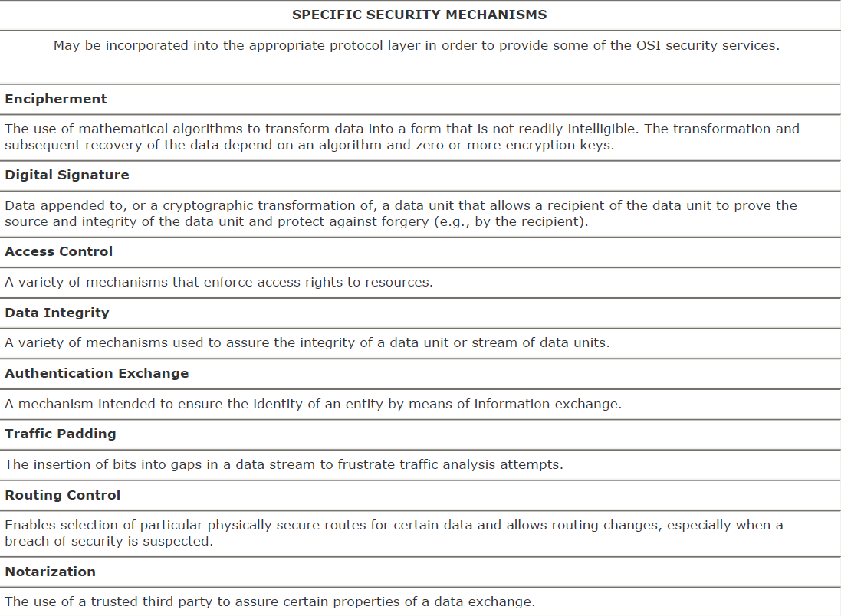
Security Mechanisms

Slide 10
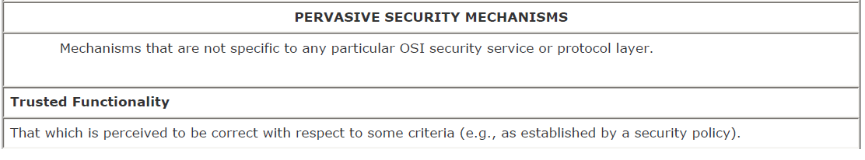
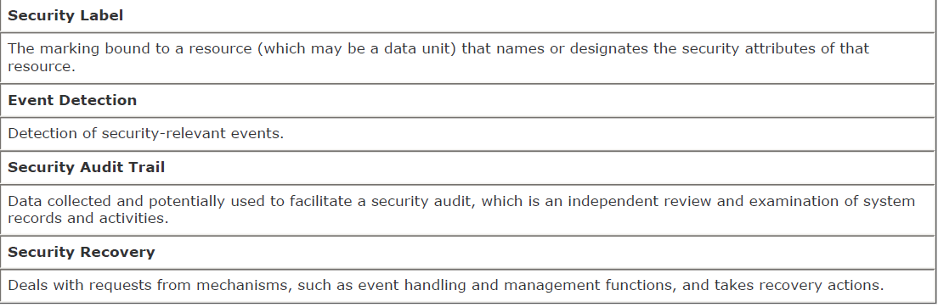

Slide 11
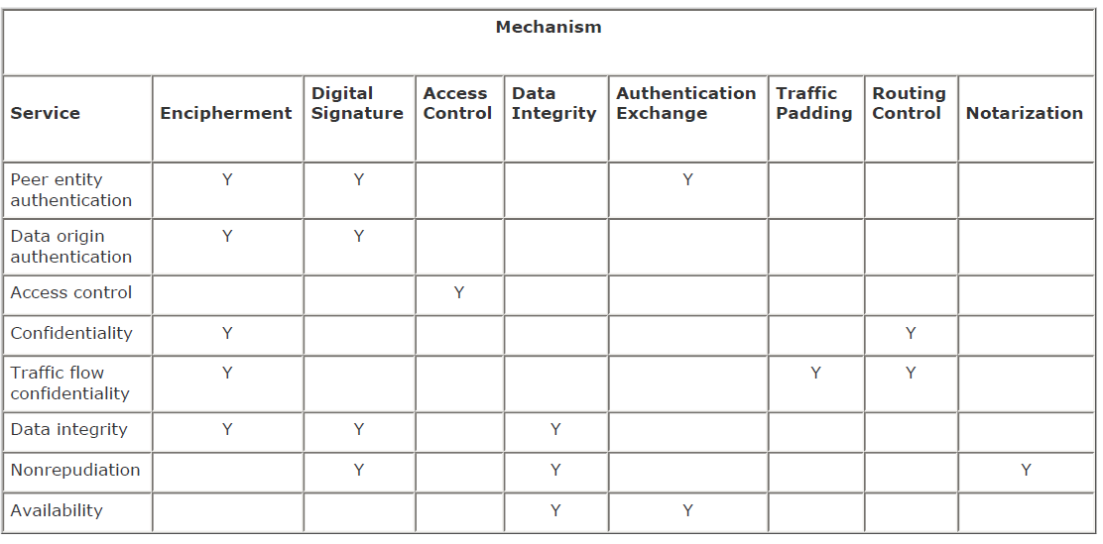
Relation between Services & Mechanisms

Slide 12
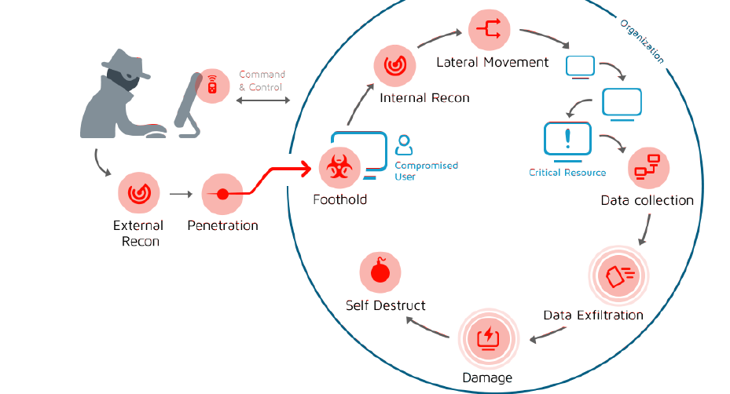
Attack Life-Cycle

Slide 13
Reconnaissance
Port Scanning
Services are using ports to communicate (HTTP = 80, DNS = 53, etc.)
When an attacker gets a foothold on a computer, he needs to move around the organization.
The attacker scans the subnet to find exposed and exploitable services on other computers and platforms.
Once an open port is found, further exploitation occurs.

Slide 14
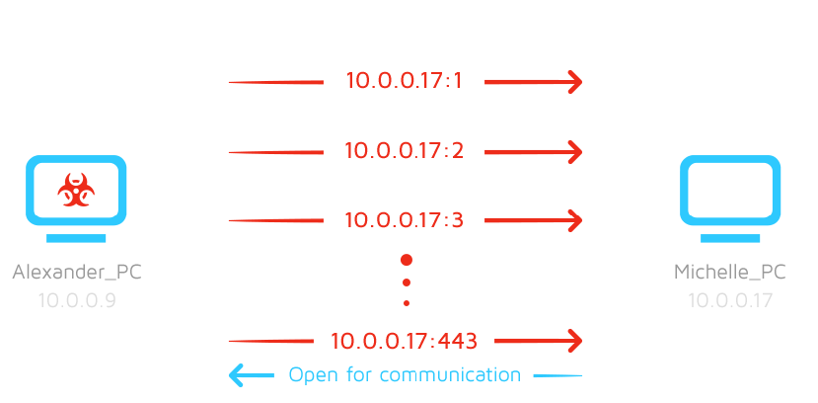

Slide 15

Spread
Lateral movement - Legitimate tools used maliciously
Pass The Hash/Ticket
Shares
PSExec

Slide 16
Spread
PSEXEC - Legitimate tools used maliciously
A legitimate tool by Microsoft.
Commonly used by IT professionals
Allows to run a process on a remote machine interactively.
Attackers use that technique to spread their malware through an entire network.

Slide 17
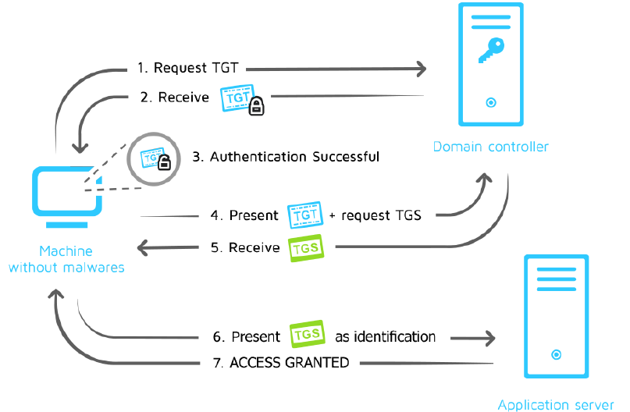
Lateral Movement

Slide 18
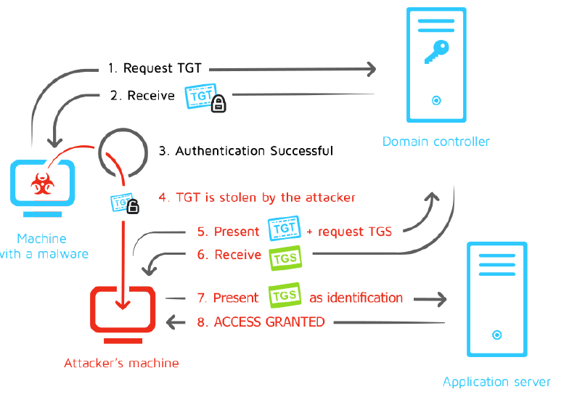

Slide 19
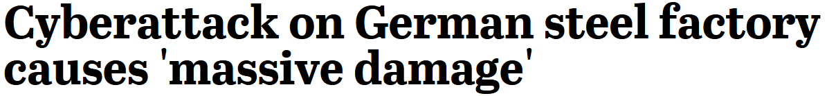
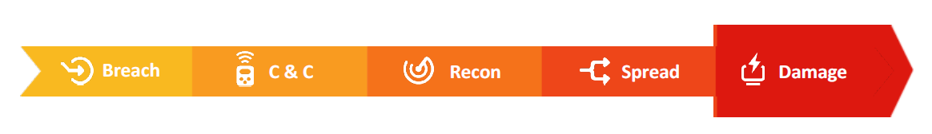
Damage. Business. Money. Physical

